Slide 1
Cloud Data Security
Server & Cloud Security
5

Slide 2
Contents
Protect Data at Rest
Protection through Encryption
Protect data in transit

Slide 3
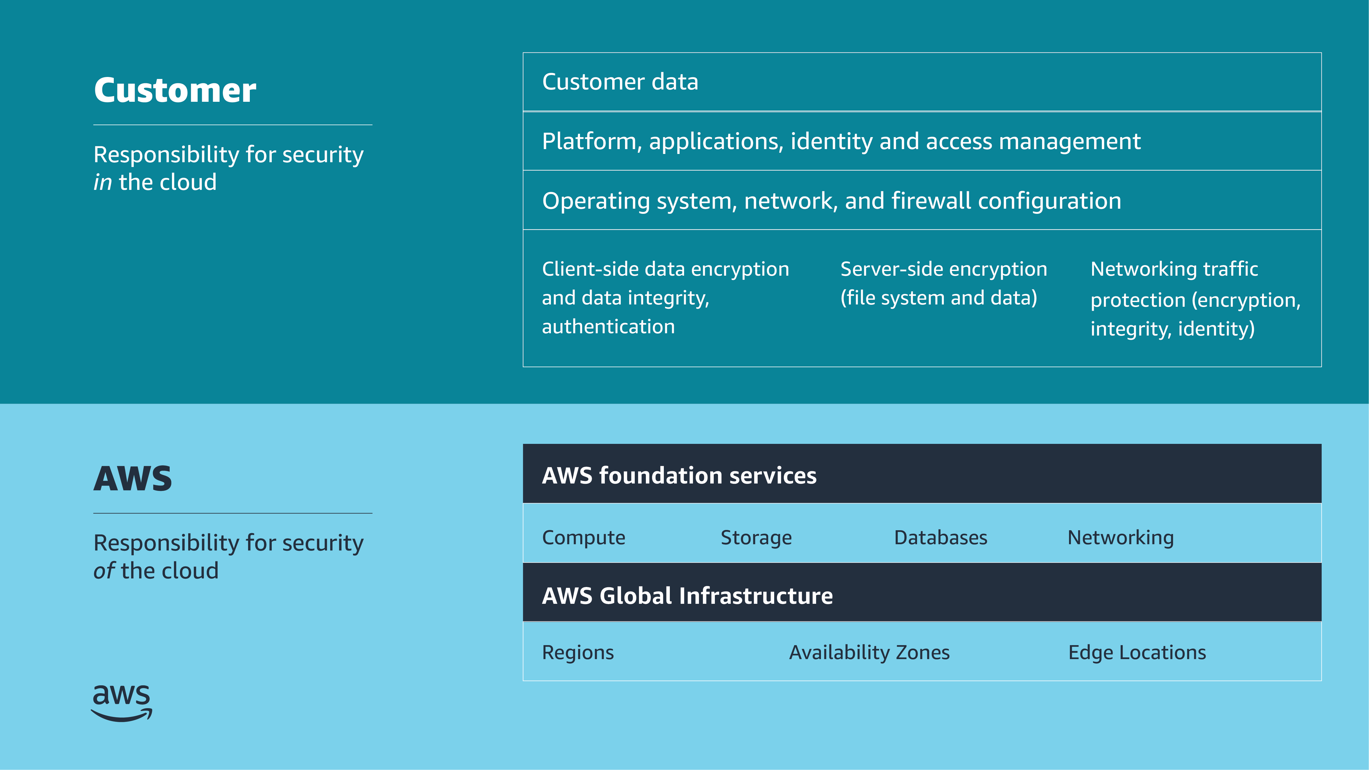
Shared responsibility model
Notes:
For accessibility: Shared responsibility model listing customer and AWS responsibilities. Customer is responsible for security in the cloud. This includes customer data. Platform, applications, identity and access management. Operating system, network, and firewall configuration. Client-side data encryption and data integrity, authentication. Server-side encryption of file system and data. Networking traffic protection, to include encryption, integrity, and identity. AWS is responsible for security of the cloud. This includes the AWS foundation services for compute, storage, databases, and networking. And the AWS Global Infrastructure, to include Regions, Availability Zones, and Edge Locations. End of accessibility description.
This module covers two portions of the shared responsibility model: client-side encryption and data integrity, including authentication, and server-side encryption (file system and data). The customer is responsible to secure these portions.

Slide 4
Protect data at rest
Protecting Data in Your Application
Notes:
This section covers how to protect data at rest.

Slide 5

Why protect data at rest?
Common scenarios
Information disclosure
Data integrity compromise
Accidental or malicious deletion
System, hardware, and software availability
Extra layer of protection if your system is compromised
Notes:
It's important to encrypt data at rest. This ensures the security of the data even if an unauthorized party gains access to it. Encrypting data at rest makes it much more difficult for attackers to compromise data, even if they can compromise an endpoint. Also, you might need to protect your data at rest due to business or compliance requirements.
The following list identifies the most common issues that make it necessary to protect your data at rest. The list also describes how to protect against each issue:
Information disclosure: Limit the number of users who can access data, and use policies to manage access to resources. Use encryption to protect confidential data.
Data integrity compromise: Use resource permissions to limit the scope of users who can modify data. Implement digital signature and encryption. Restore data from backup, or, in the case of Amazon S3, from a previous object version.
Accidental or malicious deletion: Use the correct permissions and the principle of least privilege. Restore data from backup, or, in the case of Amazon S3, from a previous object version.
System, hardware, and software availability: In the case of a system failure or natural disaster, restore your data from replicas.

Slide 6
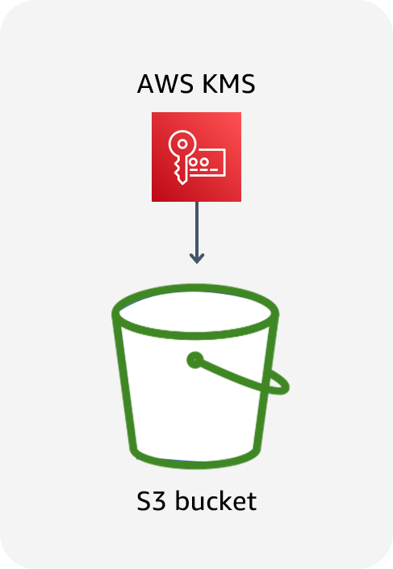
Data at rest in Amazon S3
Data stored in Amazon S3 is private by default and requires AWS credentials for access.
Use bucket policies for granular access to objects.
Consider encrypting data at rest.
Notes:
By default, all Amazon S3 resources—buckets, objects, and related subresources (for example, lifecycle configuration and website configuration)—are private. Only the resource owner, the AWS account that created it, can access the resource. The resource owner can grant access permissions to others by writing an access policy.
You can modify bucket policies to allow additional access, and AWS provides a number of tools to configure buckets for a wide variety of workloads. For example, the S3 Block Public Access feature acts as an additional layer of protection to prevent accidental exposure of data.
In addition, consider encrypting data at rest in Amazon S3.

Slide 7
Granting permissions
Identity based
(Attached to an IAM principal)
Resource based
(Attached to an AWS resource)
Bucket X
User | Get | Put | List
Bob | ALLOW | DENY | ALLOW
Bob
Resource | Get | Put | List
Bucket X | ALLOW | ALLOW | ALLOW
Bucket Y | N/A | N/A | ALLOW
Bucket Y
User | Get | Put | List
Bob | ALLOW | N/A | ALLOW
Can Bob GET, PUT, or LIST for bucket X?
Can Bob GET or LIST for bucket Y?
Notes:
Note: In the tables on the slide, N/A means not applicable because the policy doesn't specify permissions for that particular action.
Amazon S3 supports two types of access control mechanisms: identity based (or user based) and resource based.
What are the differences between identity-based and resource-based policies? They are nearly identical in appearance and function, but have some slight syntax differences. The biggest difference is where they are applied. Identity-based permissions are attached to an AWS Identity and Access Management (IAM) user and indicate what the user is permitted to do. Resource-based permissions are attached to a resource and indicate what a specified user (or group of users) is permitted to do with the resource. For example, you can attach resource-based policies to S3 buckets, virtual private cloud (VPC) endpoints, and AWS Key Management Service (AWS KMS) encryption keys. Resource-based policies are a way to restrict access on a resource basis.
In the example on the slide, an IAM user named Bob has an identity-based policy attached. The policy allows him to use the GET, PUT, and LIST APIs for bucket X. However, the resource-based policy for bucket X allows him to use GET and LIST, and denies the ability to use PUT. This means that Bob cannot PUT objects into bucket X, even though his identity-based policy allows it.
For bucket Y, Bob's identity-based policy allows the LIST action. The policy does not explicitly allow or deny the GET and PUT actions on bucket Y. The resource-based policy for bucket Y allows him to use GET and LIST, but does not specify the PUT action. Therefore, Bob can read objects from the bucket, even though his identity-based policy doesn't explicitly allow it.
For some AWS services, you can grant cross-account access to your resources by putting a policy directly on the resource that you want to share, instead of using a role as a proxy. The resource that you want to share must support resource-based policies. The policy specifies who (as a list of AWS account IDs) can access that resource.
In addition to IAM and bucket policies, Amazon S3 supports a permissions mechanism known as an access control list (ACL). An ACL is independent of IAM policies and permissions, but can be used in combination with them. However, a majority of modern use cases in Amazon S3 no longer require the use of ACLs. AWS recommends that you disable ACLs except in unusual circumstances where you need to control access for each object individually. With ACLs disabled, the S3 bucket policy becomes the sole audit surface.

Slide 8
Key takeaways: Protect data at rest
Encrypting data at rest makes it more difficult for attackers to compromise data.
Data stored in Amazon S3 is private by default and requires AWS credentials for access.
Amazon S3 supports two types of access control mechanisms:
Identity based (or user based)
Resource based
Notes:
Key takeaways from this section of the module include the following:
Encrypting data at rest makes it more difficult for attackers to compromise data.
Data stored in Amazon S3 is private by default and requires AWS credentials for access.
Amazon S3 supports two types of access control mechanisms:
Identity based (or user based)
Resource based

Slide 9
Protection through encryption
Protecting Data in Your Application
Notes:
This section covers protection through encryption.

Slide 10
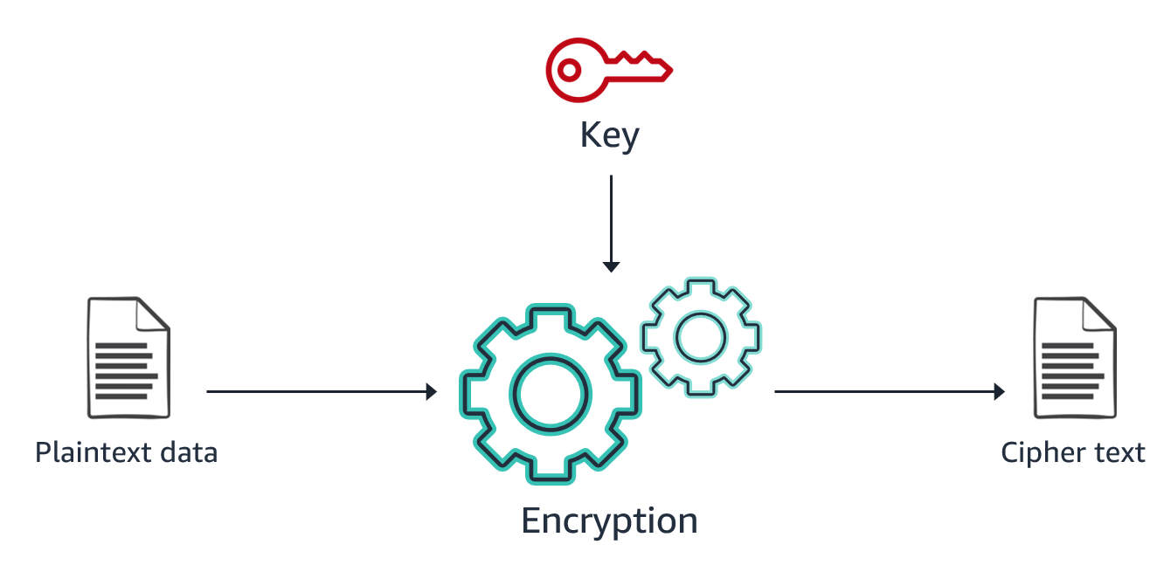
Encryption: What, how, and why
Notes:
Encryption works by using an algorithm with a key to convert plaintext data into unreadable data (ciphertext) that can only become readable again with the right key. For example, a simple phrase such as “Hello World!” might look like “1c28df2b595b4e30b7b07500963dc7c” when encrypted.
Several different encryption algorithms exist, all using different types of keys. A strong encryption algorithm relies on mathematical properties to produce ciphertext that can’t be decrypted by using any practically available amount of computing power without also having the necessary key. Therefore, protecting and managing the keys becomes a critical part of any encryption solution.

Slide 11
Comparing client-side and server-side encryption
Client-side encryption (CSE)
Server-side encryption (SSE)
Your application encrypts data before sending it to AWS.
Data is stored in its encrypted state.
The keys and algorithms are known only to you.
AWS encrypts data on your behalf after receiving it.
The process is transparent to the user.
Notes:
Depending on your security requirements, you can use client-side encryption (CSE) or server-side encryption (SSE) to encrypt your data. The approaches differ in when, where, and who encrypts and decrypts the data. The approach doesn't necessarily define how the data is encrypted. In addition, the approaches are not exclusive—you can often use CSE and SSE on the same data for an enhanced security profile. Each approach has advantages.
With client-side encryption (CSE), your applications encrypt data locally before submitting it to AWS and decrypt data after receiving it from AWS. You create and manage your own encryption keys. Data is stored in an encrypted form, with keys and algorithms known only to you.
With server-side encryption (SSE), data is encrypted at its destination by the application or service that receives it. For example, if you use SSE with Amazon S3, the service encrypts your data at the object level as it writes to disks in AWS data centers and decrypts the data for you when you access it. The encryption process is transparent to the user.
AWS supports both CSE and SSE. Most AWS services that store or manage customer data offer an SSE option or perform SSE on your data by default. These services transparently encrypt your data before writing it to disk and transparently decrypt the data when you access it. Most AWS services that support SSE are integrated with AWS KMS to protect the encryption keys that protect your data. You will learn more about AWS KMS later in this module.
For more information, see Protecting Data Using Encryption in the Amazon Simple Storage Service User Guide at https://docs.aws.amazon.com/AmazonS3/latest/userguide/UsingEncryption.html.

Slide 12
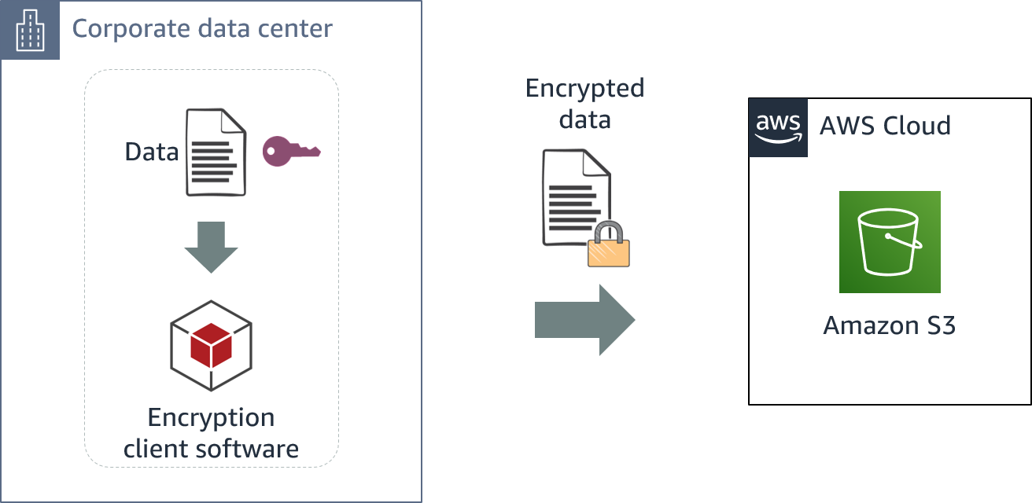
Client-side encryption
S3: Amazon Simple Storage Service
Notes:
Client-side encryption takes place before data is submitted to AWS, and decryption occurs after data is retrieved from AWS. Amazon S3 receives your encrypted data but does not play a role in encrypting or decrypting it.
To enable client-side encryption, you can use a key stored in AWS KMS or use a key that you store within your application.
AWS supports client-side encryption libraries such as the AWS Encryption SDK, Amazon DynamoDB Encryption Client, and Amazon S3 encryption clients.

Slide 13
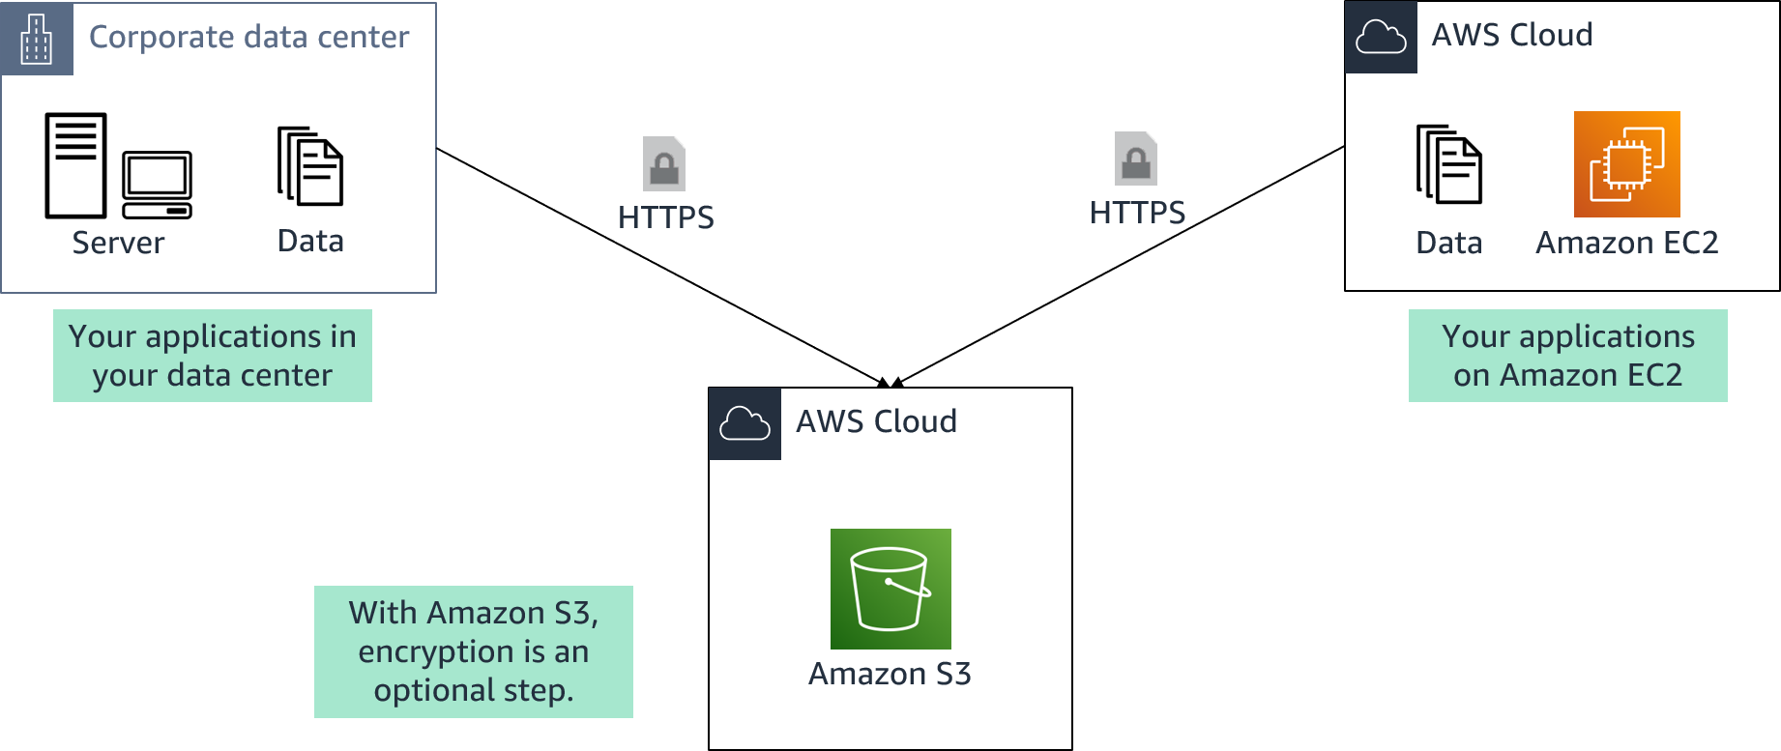
AWS server-side encryption
Notes:
Server-side encryption is the encryption of data at its destination by the application or service that receives it. With AWS server-side encryption, your source data comes from systems in your data center or an EC2 instance. You can upload that data over an HTTPS connection to any of the AWS services that support automatic server-side encryption. The service endpoint will handle the encryption and key management processes for you.
With Amazon S3, encryption is an optional step that you specify when you upload your data to the service.

Slide 14

Types of Amazon S3 server-side encryption
SSE-C
SSE-S3
SSE-KMS
You retain control of the keys.
Amazon S3 doesn't store the encryption keys that you provide.
AWS manages the keys.
The encrypted data and keys are stored in separate hosts.
AWS manages the keys.
An envelope key is used for added protection.
Notes:
For server-side encryption in Amazon S3, you have three mutually exclusive options, depending on how you choose to manage the encryption keys:
SSE with customer-provided keys (SSE-C)
With server-side encryption with customer-provided keys (SSE-C), you manage the encryption keys. With the encryption key that you provide as part of the request, Amazon S3 manages the encryption (as it writes to disks) and decryption (when you access your objects). You don't maintain the code to perform data encryption and decryption—you only maintain the keys.
Amazon S3 does not store the encryption key that you provide. Instead, a randomly salted hash-based message authentication code (HMAC) value of the encryption key is stored to validate future requests. The salted HMAC value cannot be used to derive the value of the encryption key or decrypt the contents of the encrypted object. So, if you lose the encryption key, you lose the object.
SSE with Amazon S3 managed keys (SSE-S3)
When you use server-side encryption with Amazon S3 managed keys (SSE-S3), each object is encrypted with a unique key. As an additional safeguard, Amazon S3 encrypts the key itself with a key that the service regularly rotates. SSE-S3 uses one of the strongest block ciphers available, 256-bit Advanced Encryption Standard (AES-256), to encrypt your data.
SSE with AWS KMS keys (SSE-KMS)
Server-side encryption with AWS KMS keys (SSE-KMS) is similar to SSE-S3 but with some additional benefits and charges for using the service. There are separate permissions for the use of a KMS key that provide added protection against unauthorized access of your objects in Amazon S3. SSE-KMS also provides you with an audit trail that shows when your KMS key was used and by whom. Additionally, you can create and manage customer managed KMS keys or use AWS managed KMS keys that are unique to you, your service, and your Region. AWS KMS uses envelope encryption to further protect your data. Envelope encryption is the practice of encrypting your plaintext data with a data key and then encrypting that data key with a root key.
For more information about the server-side encryption options in Amazon S3, see Protecting Data Using Server-Side Encryption in the Amazon Simple Storage Service User Guide at https://docs.aws.amazon.com/AmazonS3/latest/userguide/serv-side-encryption.html.

Slide 15
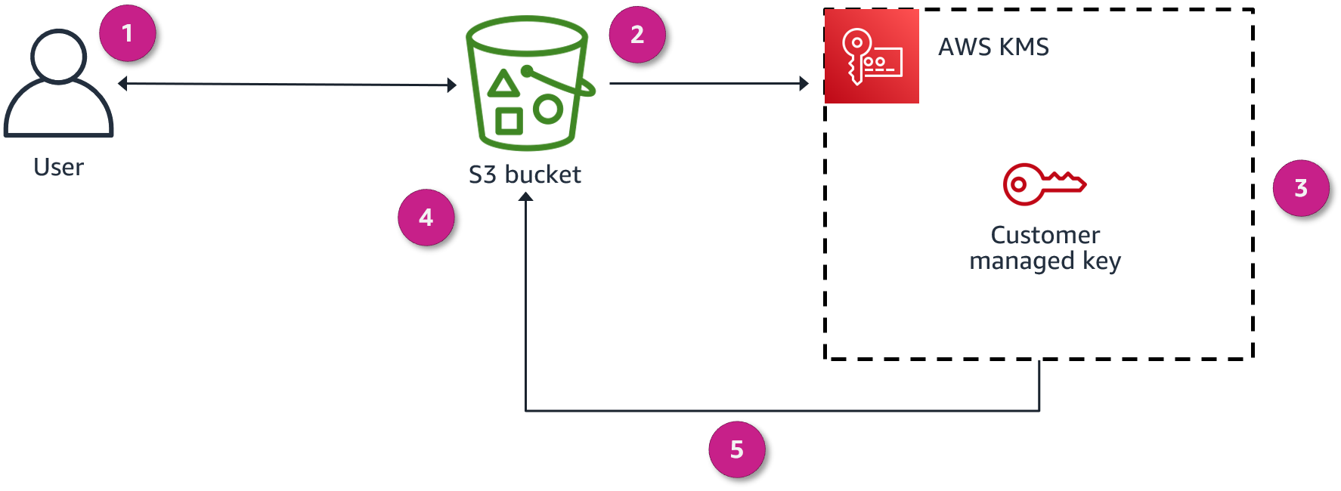
Encryption overview

Slide 16
Encryption overview
In this scenario, AMS KMS is used to encrypt data at rest (SSE-KMS). The user creates a KMS key and uses it to encrypt objects that are stored in Amazon S3. This diagram explains how encryption happens when uploading a file to Amazon S3:
You request to upload a file and store it as an encrypted object in an S3 bucket.
Amazon S3 requests a data key from AWS KMS to use to encrypt the file.
AWS KMS generates a plaintext data key and encrypts the data key by using the customer managed key.
AWS KMS sends both copies of the data key (encrypted key and plaintext data key) to Amazon S3.
Amazon S3 encrypts the object by using the plaintext data key, stores the object, and then deletes the plaintext data key. The encrypted key is kept in the object metadata.

Slide 17
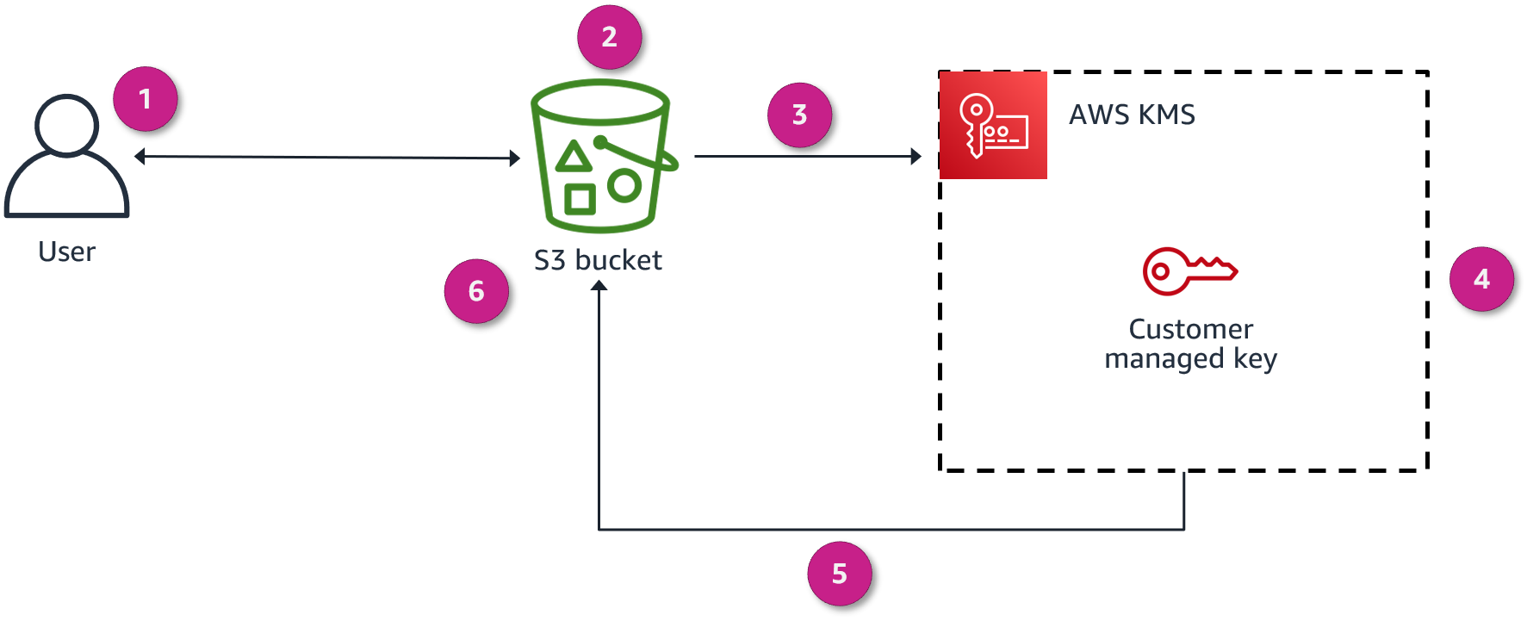
Decryption overview

Slide 18
Decryption overview
The diagram explains what happens in the same scenario (SSE-KMS) when the user requests to open an encrypted object that is stored in Amazon S3:
You request to open the object.
Amazon S3 notices that the requested object is encrypted.
Amazon S3 sends the encrypted copy of the data key that the object is encrypted with to AWS KMS.
AWS KMS then decrypts the data key by using the customer managed key (which never leaves the AWS KMS service).
AWS KMS then sends the plaintext data key back to Amazon S3.
Finally, Amazon S3 decrypts the ciphertext of the data object, allows you to open the object, and deletes the plaintext copy of the data key.

Slide 19

AWS Key Management Service (AWS KMS)
Provides the ability to create and manage cryptographic keys
Uses hardware security modules (HSMs) to protect your keys
Is integrated with other AWS services
Provides the ability to set usage policies to determine which users can use keys
AWS Key Management Service (AWS KMS)
Notes:
AWS KMS is a managed service that provides the ability to create and control the keys that are used to encrypt your data. You can create data keys with unique aliases and descriptions for better management, automatically rotate your keys on a scheduled basis, and disable or delete keys so that no one can use them. You can also import your own keys instead of using AWS generated keys.
The service uses FIPS 140-2 validated hardware security modules (HSMs) to protect keys. AWS KMS is integrated with other AWS services to help you protect the data that you store with these services. Integrated AWS services use envelope encryption to help protect your encryption keys.
With AWS KMS, you can centrally manage and securely store your keys. You can use the keys within your applications and supported AWS Cloud services to protect your data, but the keys never leave AWS KMS. This reduces the risk of having your data key compromised. You submit data to AWS KMS to be encrypted or decrypted under keys that you control.
You can set usage policies on these keys to determine which users can use them. All requests to use these keys are logged in AWS CloudTrail, so that you can understand who used which key and when. CloudTrail logs all AWS KMS operations, including read-only operations; operations that manage KMS keys; and cryptographic operations.
For more information, see the following resources:
AWS Key Management Service (AWS KMS) at https://aws.amazon.com/kms/
How AWS Services Use AWS KMS in the AWS Key Management Service Developer Guide at https://docs.aws.amazon.com/kms/latest/developerguide/service-integration.html

Slide 20
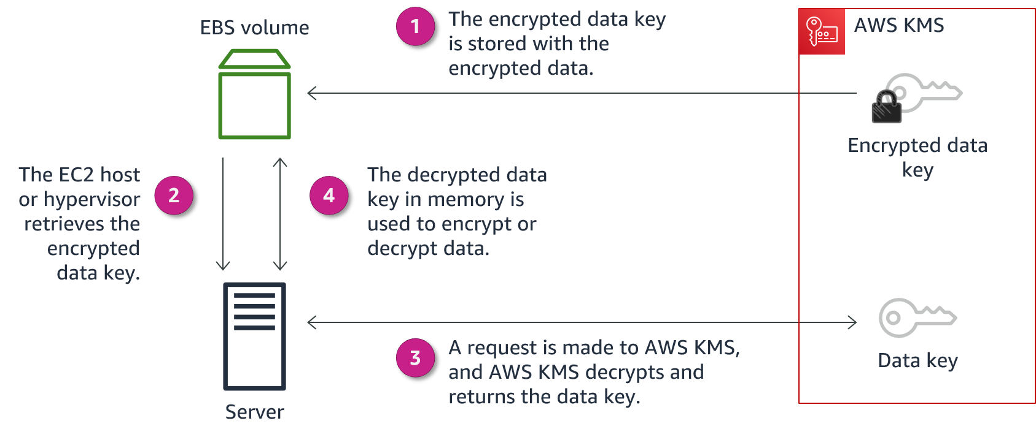
AWS KMS example with Amazon EBS
Notes:
Amazon Elastic Block Store (Amazon EBS) encryption is a straight-forward encryption solution for EBS resources that are associated with your EC2 instances. With Amazon EBS encryption, you aren't required to build, maintain, and secure your own key management infrastructure.
Amazon EBS encryption uses KMS keys when creating encrypted volumes and snapshots. Each volume is encrypted using AES-256-XTS. This requires two 256-bit keys, which you can think of as one 512-bit key. The data key is encrypted under a KMS key in your account. For Amazon EBS to encrypt a volume for you, it must have access to a customer managed key in the account. You do this by providing a grant for Amazon EBS to the customer managed key to create data keys, and to encrypt and decrypt these data keys.
The following are the basic steps to encrypt and decrypt EBS volume data:
Amazon EBS obtains an encrypted data key under a customer managed key through AWS KMS and stores the encrypted key with the encrypted data.
The servers that host EC2 instances retrieve the encrypted data key from storage.
A call is made to AWS KMS over TLS to decrypt the encrypted data key. AWS KMS identifies the KMS key, makes an internal request to an HSM in the fleet to decrypt the data key, and returns the key to the customer over the TLS session.
The decrypted data key is stored in memory and used to encrypt and decrypt all data going to and from the attached EBS volume. Amazon EBS retains the encrypted data key for later use in case the data key in memory is no longer available.

Slide 21
Protect data in transit
Protecting Data in Your Application
Notes:
This section covers how to protect data in transit.

Slide 22
Why protect data in transit?
Your communications might go through the public internet.
What are the risks that data in transit is exposed to?
Accidental information disclosures
Data integrity compromises
Identity compromises
Man-in-the-middle (MITM) attacks
Identity spoofing
Notes:
Data in transit is data that is actively moving from one location to another, such as across the internet or through a private network. To protect data in transit, you protect data while it's traveling from network to network or being transferred from a local storage device to a cloud storage device. Wherever data is moving, protection measures are critical, as data is often considered less secure while in motion.
Cloud applications often communicate over public links, such as the internet, so it's important to protect data in transit when you run applications in the cloud. This involves protecting network traffic between clients and servers, and network traffic between servers.
While being transferred through various applications and networks, data in transit is exposed to the following risks:
Accidental information disclosures
Data integrity compromises
Identity compromises
Man-in-middle (MITM) attacks
Identity spoofing
A man-in-the-middle (MITM) attack is a form of cyberattack in which criminals exploit weak web-based protocols to insert themselves between entities in a communication channel to steal data. The attacker is in the middle of ongoing communication between two entities. This type of attack makes the network vulnerable to packet sniffing and modification.

Slide 23
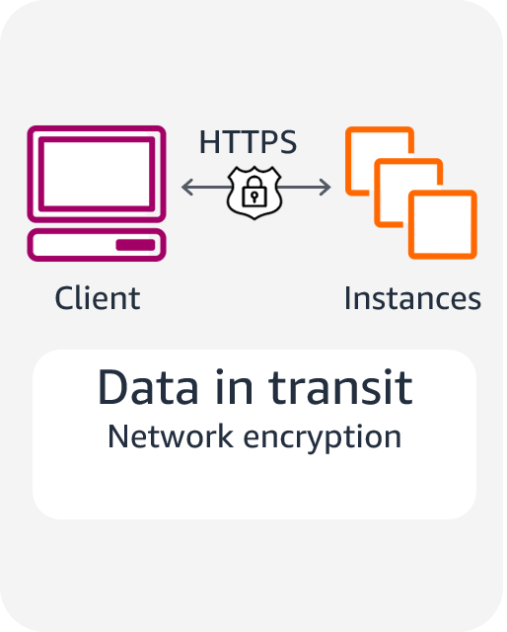
Protecting data in transit
Use Secure Sockets Layer (SSL) endpoints over Transport Layer Security (TLS) (HTTPS).
Use encryption.
Use Amazon Virtual Private Cloud (Amazon VPC) endpoints to limit access to your bucket.
Notes:
You can protect data in transit by using Secure Sockets Layer (SSL) or client-side encryption. You can securely upload your data to or download it from Amazon S3 through SSL endpoints by using the HTTPS protocol. Client-side encryption will protect your data in transit because the data is encrypted before you send it to Amazon S3.
You can also limit access to an S3 bucket from a specific Amazon Virtual Private Cloud (Amazon VPC) endpoint or a set of endpoints by using S3 bucket policies.
To protect data in transit, AWS encourages customers to use a multi-level approach. All network traffic between AWS data centers is transparently encrypted at the physical layer. All traffic within a VPC and between peered VPCs across AWS Regions is transparently encrypted at the network layer when using supported EC2 instance types. At the application layer, customers have a choice about whether and how to use encryption by using a protocol such as Transport Layer Security (TLS). All AWS service endpoints support TLS to create a secure HTTPS connection to make API requests.

Slide 24
Protecting remote connections to servers
Remote Desktop Protocol (RDP) is typically used for Windows servers.
RDP establishes an underlying SSL/TLS connection.
For better security, issue a trusted X.509 certificate.
Don't use the default self-signed certificates.
Secure Shell (SSH) is typically used for Linux servers.
SSH establishes a secure communication channel.
Use tunneling to protect the application session in transit.
Don't allow the root user to use an SSH terminal.
Be sure that all users log in with an SSH key pair, and then deactivate password authentication.
Notes:
Users who access Windows Terminal Services in the public cloud usually use the Microsoft Remote Desktop Protocol (RDP). By default, RDP connections establish an underlying SSL/TLS connection. For optimal protection, the Windows server being accessed should be issued a trusted X.509 certificate to protect from identity spoofing or man-in-the-middle attacks. By default, Windows RDP servers use self-signed certificates, which are not trusted and should be avoided.
Secure Shell (SSH) is the preferred approach to establish administrative connections to Linux servers. SSH is a protocol that, like SSL, provides a secure communications channel between the client and server. SSH supports tunneling, which you should use to run applications such as X-Windows on top of SSH and to protect the application session in transit. By default, Amazon Machine Images (AMIs) that AWS and most vendors from the AWS Marketplace provide don't allow the root user to log in from an SSH terminal. The default configuration for AWS provided AMIs is logging in with an SSH key pair with password authentication deactivated.

Slide 25

AWS Certificate Manager (ACM)
Provides a single interface to manage both public and private certificates
Makes it easy to deploy certificates
Protects and stores private certificates
Minimizes downtime and outages with automatic renewals
AWS Certificate Manager (ACM)
Notes:
By making it easy to enable SSL/TLS, AWS Certificate Manager (ACM) helps organizations to meet regulatory and compliance requirements for encryption of data in transit. ACM handles the complexity of creating and managing public SSL/TLS certificates for your AWS based websites and applications. You can also use ACM to issue private SSL/TLS X.509 certificates that identify users, computers, applications, services, servers, and other devices internally.
ACM provides a single interface for you to manage both public and private certificates. With ACM, you can easily create and deploy public and private certificates for your on-premises resources, such as internal servers and Internet of Things (IoT) devices. You can also deploy private or public certificates on AWS resources, such as load balancers, Amazon CloudFront distributions, and Amazon API Gateway endpoints by using the AWS Management Console or the ACM API.
ACM is also designed to protect and manage private certificates. The service can also help you minimize downtime due to misconfigured or expired certificates. ACM helps manage the challenges of maintaining certificates, including certificate renewals so that you don’t have to worry about outages that result from expiring certificates. Renewed certificates are deployed automatically on AWS resources.

Slide 26
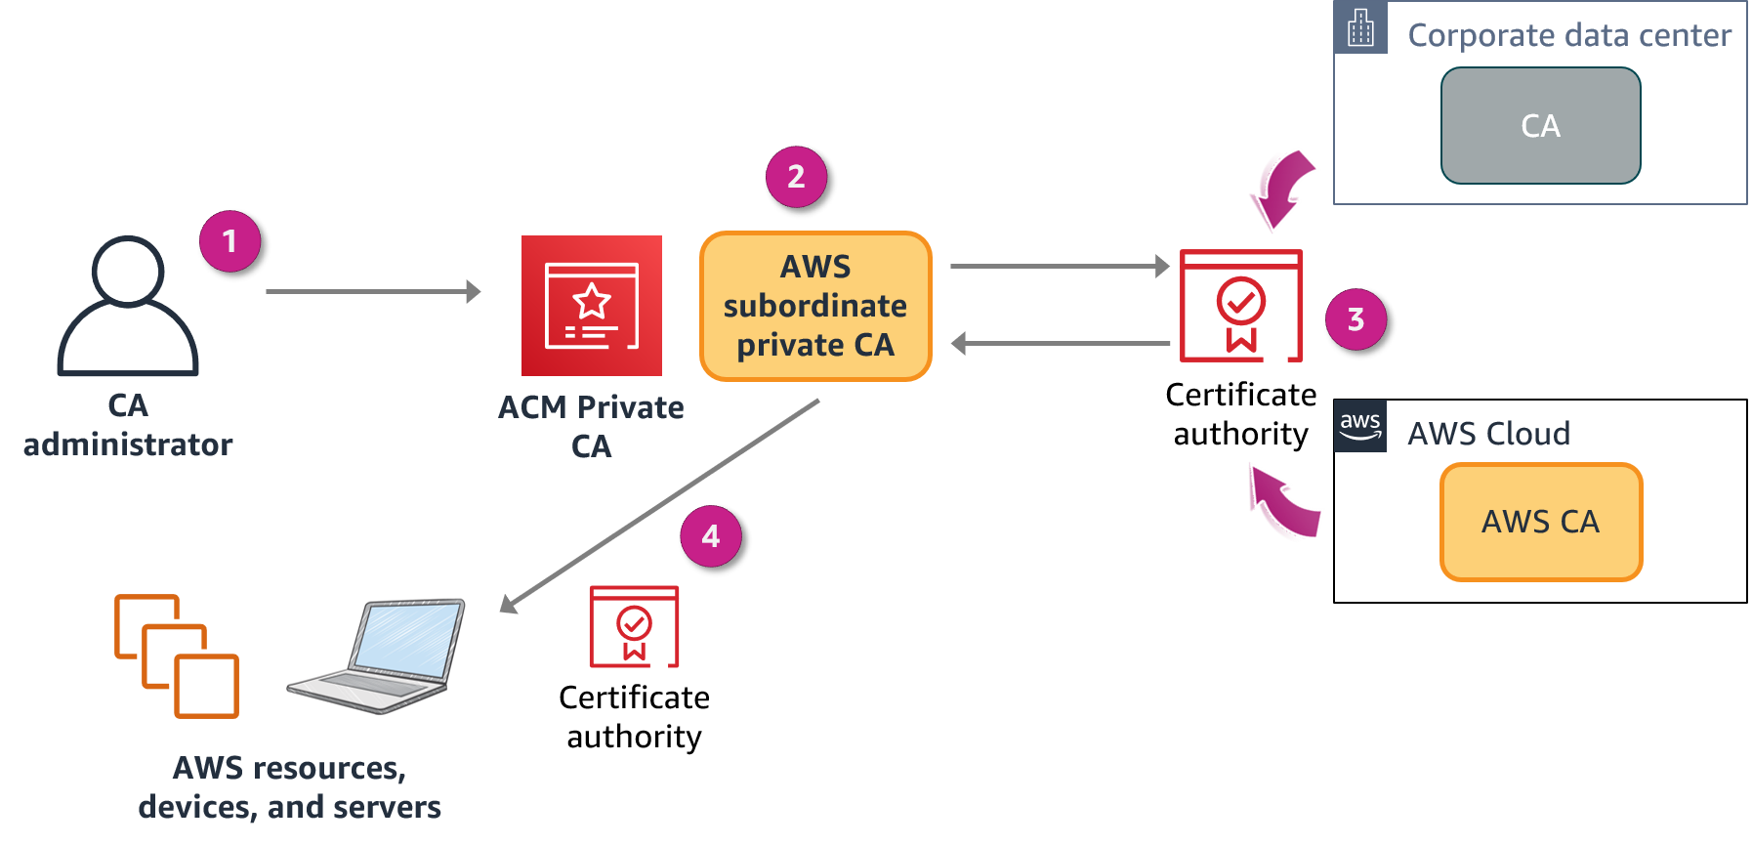
AWS Certificate Manager Private Certificate Authority
Notes:
By using AWS Certificate Manager Private Certificate Authority, you can create private certificate authority (CA) hierarchies, including root and subordinate CAs, without the investment and maintenance costs of operating an on-premises CA. Your private CAs can issue end-entity X.509 certificates, which are useful in scenarios such as the following:
Creating encrypted TLS communication channels
Authenticating users, computers, API endpoints, and IoT devices
Cryptographically signing code
Implementing Online Certificate Status Protocol (OCSP) to obtain certificate revocation status
ACM Private CA is for enterprise customers who are building a public key infrastructure (PKI) inside the AWS Cloud. The service is intended for private use within an organization. With ACM Private CA, you can create your own CA hierarchy and issue certificates with it to authenticate internal users, computers, applications, services, servers, and other devices, and to sign computer code. Certificates that a private CA issues are trusted only within your organization, not on the internet. After creating a private CA, you have the ability to issue certificates directly (that is, without obtaining validation from a third-party CA) and to customize them to meet your organization's internal needs.
The diagram shows ACM Private CA in action:
The CA administrator creates a subordinate CA to issue certificates.
The subordinate CA sends the certificate to be signed.
The on-premises CA or AWS CA signs the certificate.
ACM Private CA issues the signed certificate to resources.

Slide 27



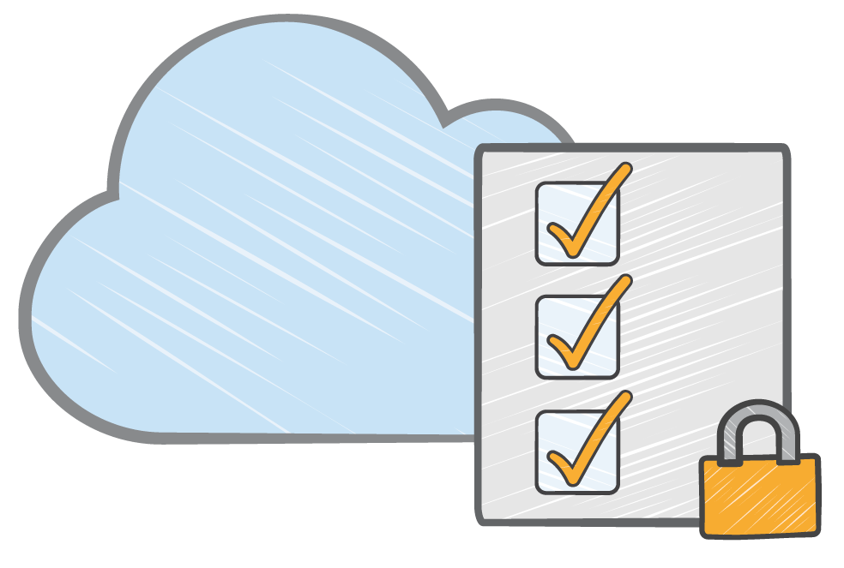

ACM Private CA considerations
Hardware security modules (HSMs)
IAM policies for access control
Certificate revocation
list
Generated audit
reports
Notes:
ACM Private CA is secured with HSMs. These HSMs adhere to FIPS 140-2 Level 3 security standards to help protect your private CA against key compromises. CA administrators can also control access to the service by using IAM policies. ACM Private CA publishes and updates certificate revocation lists to an S3 bucket automatically to help prevent the use of revoked certificates. For instance, an IoT application can check if the private certificate for a sensor is valid before accepting data from the sensor. ACM Private CA also creates another S3 bucket that provides the ability to generate audit reports.
Securing internal services is a common use case for ACM Private CA. For example, a private certificate is useful to secure connections to your load balancers, API endpoints, applications, and internal Wi-Fi. This service is also an infrastructure component of ACM, which has a wide variety of uses of its own. Examples include managing private certificates with the benefit of managed renewals and certificate binding, and issuing private certificates to identify AWS resources, such as EC2 instances, Amazon Simple Notification Service (Amazon SNS) messages, or IoT devices. ACM Private CA also works well for customers who want a replacement for self-signed certificates and automation through APIs.

Slide 28
Key takeaways: Protect data in transit
Protect data in transit by using SSL or client-side encryption when you run applications in the cloud.
Use VPC endpoints to limit access to S3 buckets.
The ACM service handles the complexity of creating and managing public SSL/TLS certificates for your AWS based websites and applications.
ACM Private CA can manage the lifecycle of your private certificates centrally and in a highly available way.
Notes:
Key takeaways from this section of the module include the following:
Protect data in transit by using SSL or client-side encryption when you run applications in the cloud.
Use VPC endpoints to limit access to S3 buckets.
The ACM service handles the complexity of creating and managing public SSL/TLS certificates for your AWS based websites and applications.
ACM Private CA can manage the lifecycle of your private certificates centrally and in a highly available way.

Slide 29
Summary
Protect Data at Rest
Protection through Encryption
Protect data in transit

